Slide 1




CARBON SUPPORTED METAL OXIDES PRODUCED BY SUPERCRITICAL WATER IMPREGNATION METHOD
(acronym APASUPER)
P4 – Fundamental and Frontier Research
Exploratory Research Project (PCE),
PN-III-P4-ID-PCE-2020-1241; Contract no. 111/2021
Director: Dr. Florentina Violeta MAXIM
04.01.2021 – 31.12.2023
(Romanian version bellow)

Slide 2
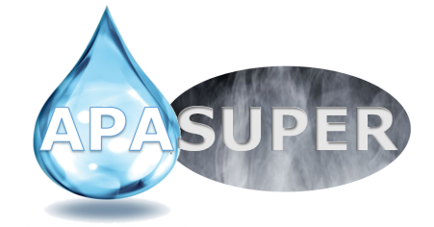
Summary
The APASUPER project deals with preparation, characterization and testing supported metal oxides (Me_{x}O_{y}) to be used as sorbent materials in separation processes carried out under supercritical water (scH₂O) conditions. The one-step preparation method (continuous scH₂O impregnation of metal oxides on carbon) is here presented as novelty. It will be developed by combining the available knowledge with the very recent information on the coexistence of gas- and liquid-like phases, observable when scH₂O interacts with porous carbon (Maxim et al. Nat. Comms. 2019). The project has both an exploratory and an inter-disciplinary character and aims to be the first step towards long-term collaboration between the Institute of Physical Chemistry, Romania (host ICF-RO) and Paul Scherrer Institute, Switzerland (main partner PSI-CH). During the research stages at the Swiss partner, cutting-edge research will be performed at PSI’s large-scale facilities using neutron/synchrotron radiation. In this way, the project will contribute to spread the excellence within Europe by bringing the scH₂O science to the attention of the Romanian research community. The materials prepared, characterized and tested during this project might contribute to the implementation at large-scale of the promising scH₂O technologies, which can in turn help to achieve the 6th (clean water and sanitation) and the 7th (affordable and clean energy) Sustainable Development Goals on UN’s new 2030 agenda.

Slide 3
Main Objectives
O1: To prepare Me_{x}O_{y} on C support by continuous flow scH₂O impregnation method. This is the main goal of the project, and it will be achieved based on the knowledge available in the literature about the continuous scH₂O synthesis of well-defined nanoparticles, and the possibility to obtain high loading and dispersion of the metal oxide on porous support by scH₂O impregnation procedure. Moreover, the modelling and simulations component of the project will provide insights into the hydrodynamics and the kinetics of reactions occurring in scH₂O, which in turn will help to optimize the preparation method.
O2: To establish the relationship between the preparation method and the sorbent material formulation. To accomplish this goal, the APASUPER project will focus on structural and morphological characterization of the composite materials in order to determine the sorbent formulation in terms of Me_{x}O_{y} crystallinity, size and morphology, as well as the amounts of loading and the concentration profile of the active element within the pores of the support. Additionally, the in-situ measurements will give a strong base for understanding how the various parameters of the preparation method will influence the structure and the functionality of the composite materials. Moreover, a thermodynamic approach will be developed in order to understand the effects of various parameters, such as composition, structure, particle size and shape, as well as of the preparation conditions (temperature, pressure and concentration) on the thermodynamic stability of the Me_{x}O_{y} sorbents under different operating conditions.
O3: To test the sorption capacity of the composite materials. The S-capturing capacity of as produced sorbent materials will be evaluated in similar operating conditions of the target technological applications. The sorbents performance will be compared through analysis of their breakthrough curves, adsorption rates and values of adsorption capacity. Moreover, ex-situ measurements allowing determination of the S speciation, both in aqueous solutions and within spent sorbent materials, will help to get insights of the physisorption and/or the chemisorption mechanisms.

Slide 4
Research Team
Name | Position | Role in project
Florentina Violeta Maxim | Scientific Researcher, CSIII | Project leader
Florina Teodorescu | Scientific Researcher, CSII | Team member
Ovidiu Cristian Hornoiu | Scientific Researcher, CSII | Team member
Ancuta Sofronia | Scientific Researcher, CSIII | Team member
Iuliana Poenaru | Research Assistant | Team member
Elena Ecaterina Toma | Research Assistant | Team member
Giuseppe Stefan Stoian | Research Assistant | Team member
Mihail Calin Licu | Research Assistant | Team member
Cristina Elena Negoita | Research Assistant | Team member

Slide 5





Collaborators
Prof. Christian Ludwig
Dr. Pierre Boillat
Dr. Bojan Niceno
Dr. Camelia Borca
Dr. Andrea Testino
Dr. Speranta Tanasescu
Dr. Irina Atkinson
Dr. Cornelia Marinescu
Ing. Cristian Iacob
Dr. Konstantinos Karalis
Dr. Cristian Contescu
Prof. Daniel Banuti

Slide 6
Budget (lei)
Category of expenses | 2021 | 2022 | 2023 | TOTAL
Personnel | 138.298 | 189.158 | 212.469 | 539.925
Logistics | 141.718 | 141.718 | 141.718 | 425.154
Travel | 38.997 | 38.997 | 38.997 | 116.991
Overhead | 37.810 | 34.703 | 43.449 | 115.962
TOTAL | 356.823 | 404.576 | 436.633 | 1.198.032

Slide 7
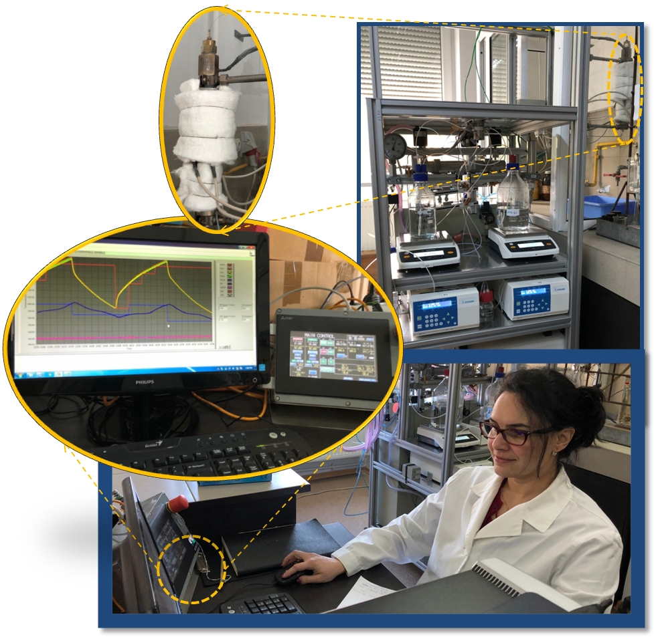
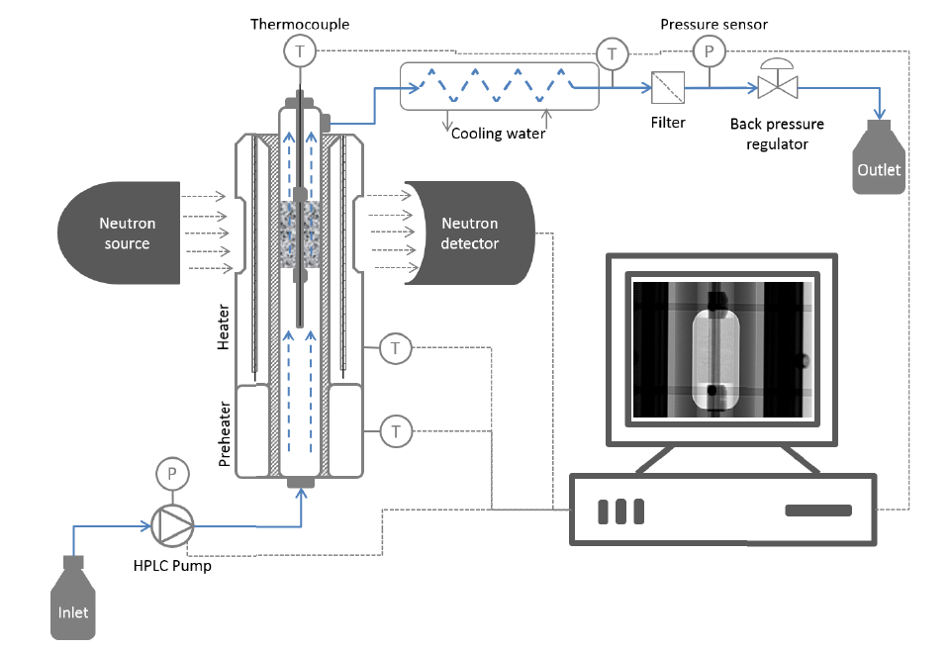
Main Infrastructure – NISA equipment
Neutron Imaging ScH₂O Analysis
International Scientific Collaboration: Research collaboration agreement with Equipment transfer between ICF and Paul Scherrer Insititute, Villigen, Switzerland
Continous flow tubular reactor with heater and pre-heater;
HPLC pums;
Back pressure regulator;
DAQ system and GOT panel
1
3
1
3
4
4
2
2
NISA schematic representation
Maxim, F et al. Visualization of supercritical water pseudo-boiling at Widom line crossover. Nat Commun 10, 4114, (2019).
NISA equipment installed at ICF-Ro

Slide 8
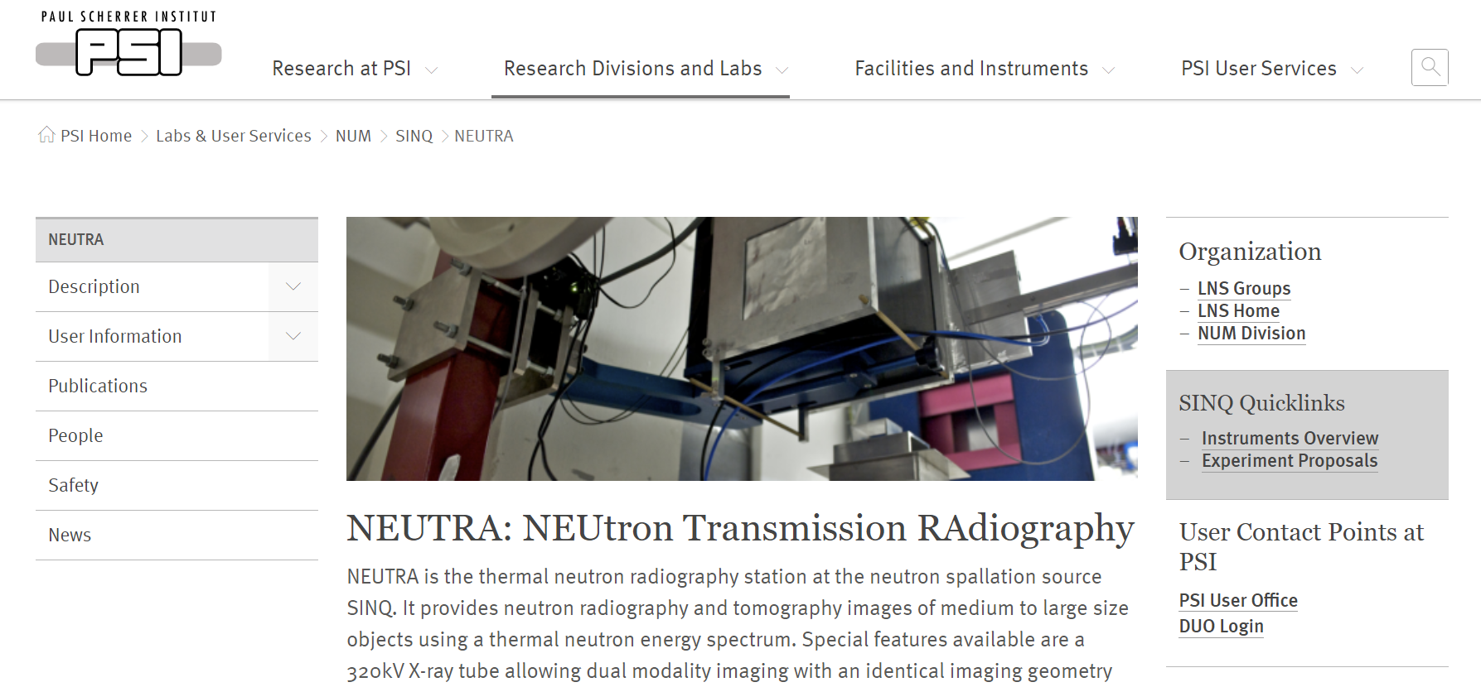
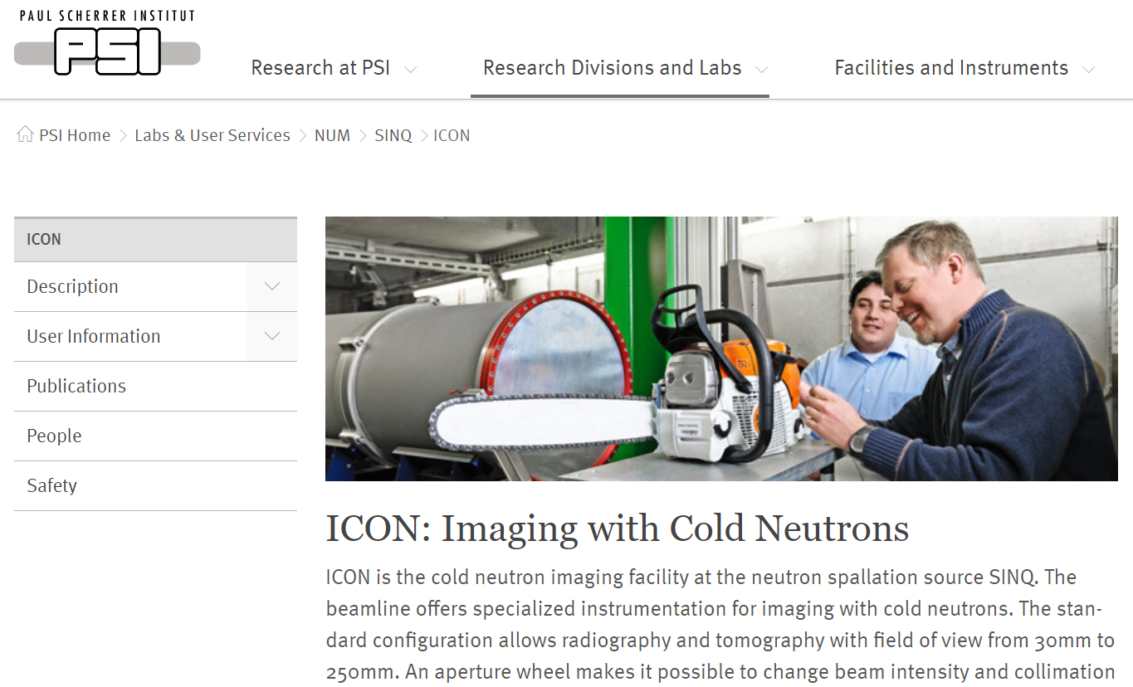
In-situ Neutron Imaging campaign
June 2021 at large scale facility SINQ-PSI: https://www.psi.ch/en/sinq
Proposal-number: 20202259
Proposal-number: 20201992

Slide 9
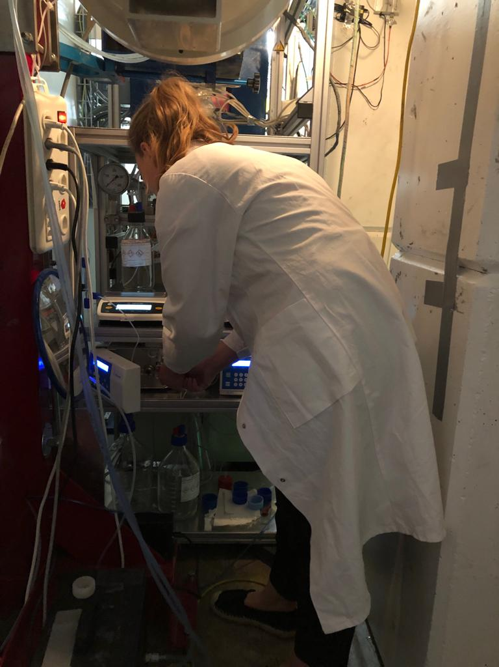
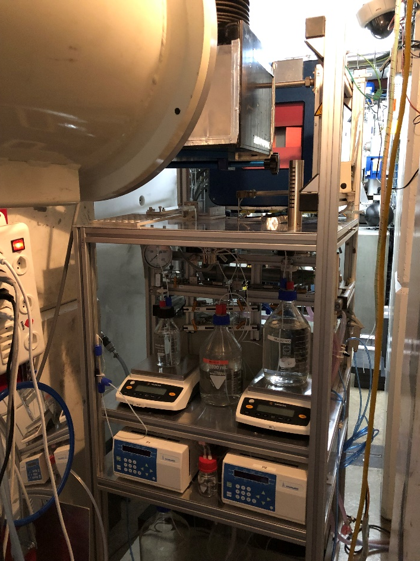
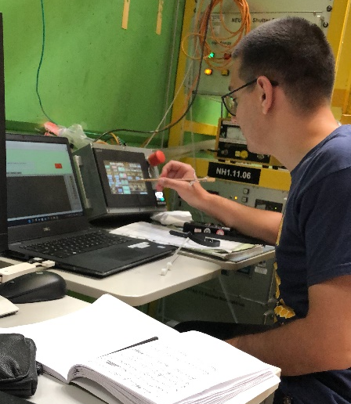
In-situ Neutron Imaging campaign
July 2022 at large scale facility SINQ-PSI: https://www.psi.ch/en/sinq
NISA installed at the beamline and operated by the young team members
NEUTRA Proposal-number: 20212507
ICON Proposal-number: 20212508

Slide 10
Structure of Me_{x}O_{y}/C composites
ZnO/C
Cu_{x}O_{Y}/C
TiO₂/C

Slide 11
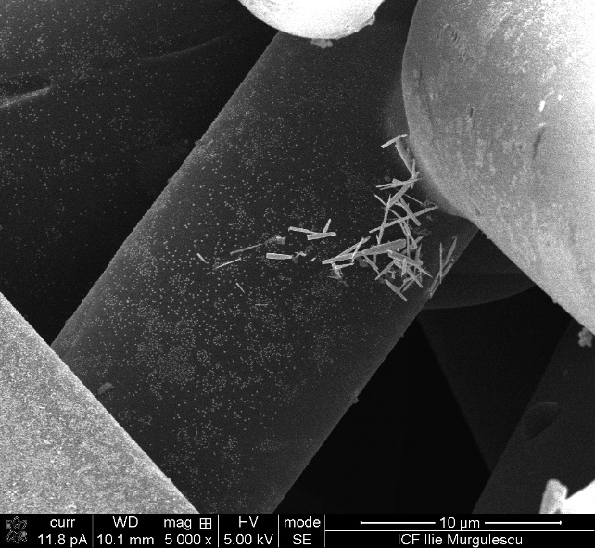
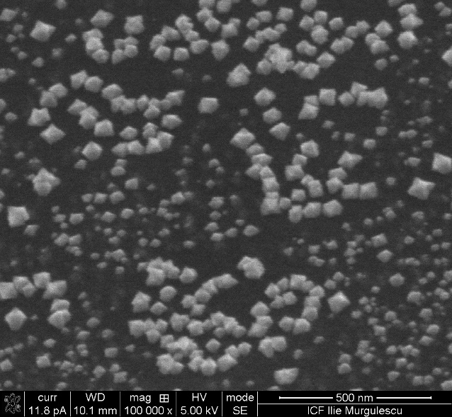
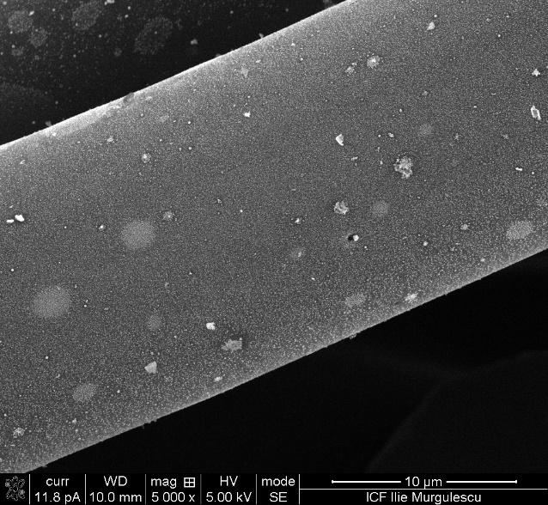
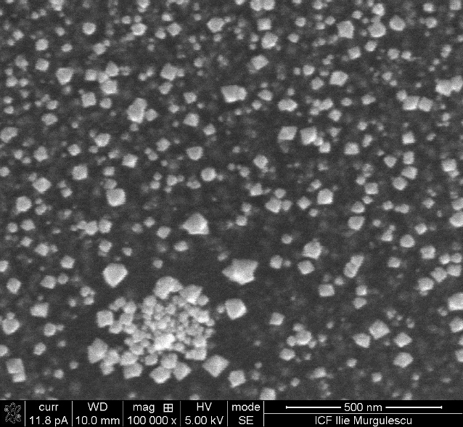
Morphology of Me_{x}O_{y}/C composites
a)
b)
c)
d)
ZnO/C
Cu_{x}O_{Y}/C
10 μm
500 nm
10 μm
500 nm
e)
f)
g)
TiO₂/C
10 μm
2 μm
200 nm

Slide 12
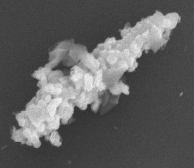
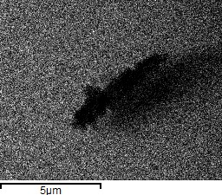
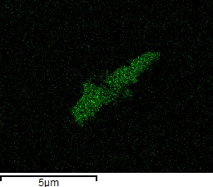
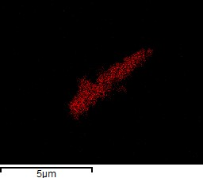
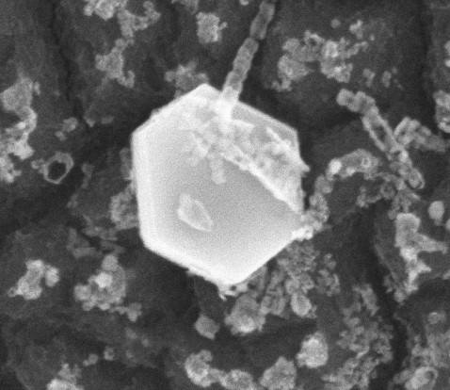
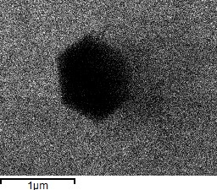
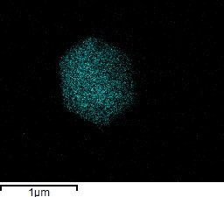
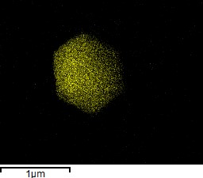
Sulfur capturing on Me_{x}O_{y}/C composites
a)
b)
C
c)
S
d)
Zn
5 μm
5μm
5μm
5μm
e)
f)
C
g)
S
h)
Cu
1μm
1μm
1μm
1μm
Formation of Zn-S and Cu-S compounds

Slide 13
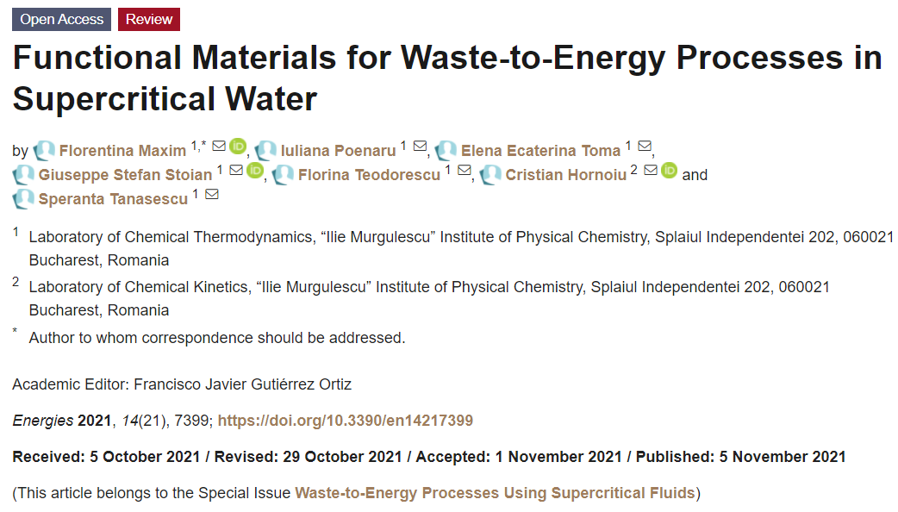
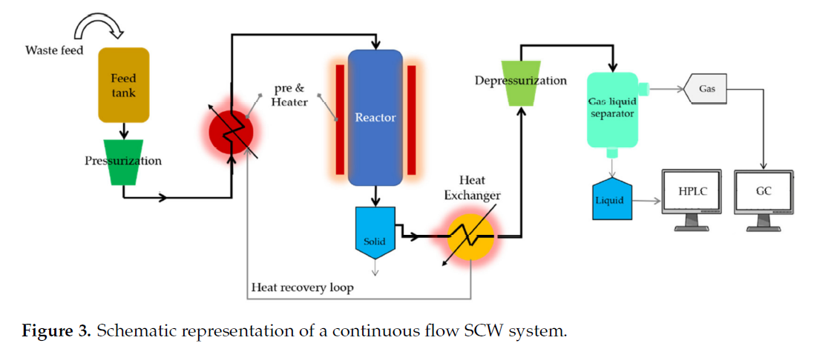
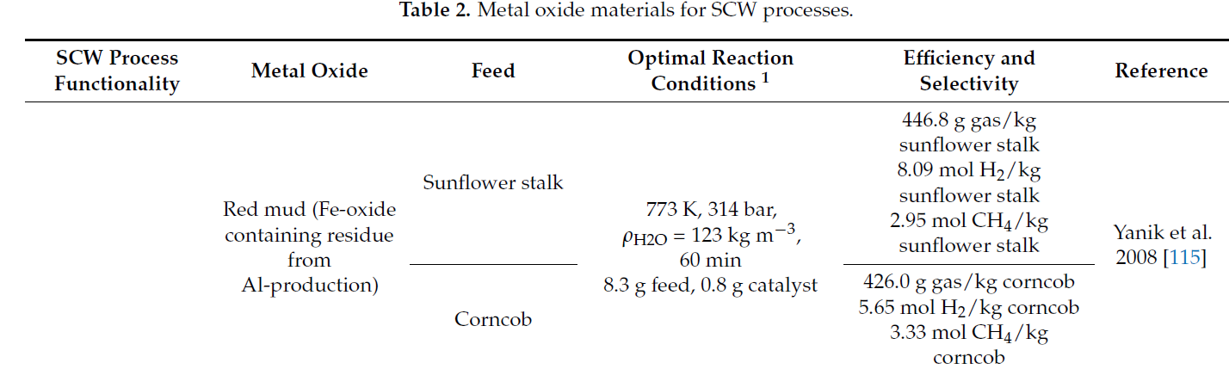
Results Dissemination (Publications)
Maxim F., Poenaru I., Toma E.E., Stoian G. S., Teodorescu F., Hornoiu C., Tanasescu S., Functional Materials for Waste-to-Energy Processes in Supercritical Water, Energies 2021, 14(21), 7399; https://doi.org/10.3390/en14217399

Slide 14
Results Dissemination (Conferences)
Maxim F.; Poenaru I.; Toma E.E.; Stoian G.S.; Teodorescu F.; Hornoiu C.; Tanasescu S., Functional materials for emerging technologies using supercritical water as green solvent, 2nd International Symposium on Water, Ecology and Environment (ISWEE 2021), October 15th-18th, 2021,Online: ISWEE (iswee-conf.com), Invited talk.
Maxim F., Supercritical water pseudo-boiling, prezentare orala, online la Institute of Aerospace Thermodynamics, în cadrul “Seminar for Multiphase Flows” Collaborative Research Center Transregio 75, October, 21st 2021, University of Stuttgart, Germania, Invited talk.
Toma E. E., Poenaru I., Atkinson I., Stoian G., Maxim F., Supercritical water impregnation approach in the preparation of ZnO/activated carbon composites, 4th International Conference on Emerging Technologies in Materials Engineering – EmergeMAT, 4-5 Noiembrie 2021 – Bucharest, Romania, Online: https://imnr.ro/wp/emergemat-iv-poster-section-iv-materials-for-energy-harvesting-and-storage/, Poster.
Maxim F., Toma E. E., Poenaru I., Stoian G. S., Conțescu C., Ludwig C., Tănăsescu S., Apa în condiții supercritice: studiul termodinamic și aplicații, a II-a Conferință a Cercetării Științifice din Academia Română (CCSAR-2021), 23 noiembrie 2021, Online: https://acad.ro/com2021/pag_com21_1122.htm, Oral presentation.

Slide 15
Results Dissemination (Conferences)
Maxim F., Water phase changes in the supercritical domain, 2nd International Solvothermal and Hydrothermal Association seminar, 13th of June 2022, seminar online, Tohoku University, Japan, Invited talk.
Maxim F., Toma E. E., Stoian G. Ș., Karalis K., Niceno B., Ludwig C., Tănăsescu S., Termodinamica transformărilor de fază din domeniul supercritic al apei, Simpozion omagial 120 de ani de la nașterea Academicianului ILIE MURGULESCU, 30-31 martie 2022, București, Romania, Oral presentation.
Maxim F., Toma E. E., Stoian G. Ș., Teodorescu F., Tănăsescu S., Metal Oxide Nanomaterials on Carbon Support Prepared by Supercritical Water Impregnation Method, 19th International Conference on Advanced Nanomaterials ANM2022, 27-29 of July 2022, University of Aveiro, Portugal, Oral presentation.
Stoian G., Toma E. E., Atkinson I., Maxim F., CARBON SUPPORTED COPPER OXIDE PRODUCED BY SUPERCRITICAL WATER IMPREGNATION METHOD, 5th International Conference on Emerging Technologies in Materials Engineering– EmergeMAT, 27-28 October 2022, Bucharest, Romania, Poster.

Slide 16
Results Dissemination (Conferences)
Toma E. E. , Stoian G. S., Coman S. M., Maxim F., ZnO nanoparticles with enhanced photocatalytic efficiency produced in continuous flow supercritical water conditions, XVIII EcerS Conference & Exhibition, 2-6 July 2023, Lyon, Franța, Poster.
Maxim F., Toma E. E., Stoian G. S., Contescu C., Atkison I., Ferro M., Ludwig C., Continuous supercritical water impregnation method for the preparation of carbon-supported metal oxide composite materials, XVIII EcerS Conference & Exhibition, 2-6 July 2023, Lyon, Franța, Oral presentation.
Licu, M. C., Stoian, G., Toma, E., Maxim, F., Heat transfer in supercritical water reactor, 8th International Solvothermal and Hydrothermal Association Conference, september 10-13 2023, Valladolid, Spain, Oral presentation.
Stoian, G.S., Toma, E.E., Maxim, F., Supercritical water impregnation of zinc oxide nanoparticles on carbon support, 8th International Solvothermal and Hydrothermal Association Conference, september 10-13 2023, Valladolid, Spain, Oral presentation.
Licu M. C., Stoian G. Ş., Toma E. E., Maxim F., Study of the heat transfer to supercritical water during pseudo-boiling phase transition, International Conference of Physical Chemistry - ROMPHYSCHEM 17th edition, September 25-27, 2023, Bucharest, Romania, Poster.

Slide 17
Results Dissemination (Conferences)
Stoian G., Toma E., Sofronia A., Tănăsescu S., Maxim F., Thermodynamic characteristics of the carbon-supported copper oxides obtained by supercritical water impregnation approach, International Conference of Physical Chemistry - ROMPHYSCHEM 17th edition, September 25-27, 2023, Bucharest, Romania, Poster.
E. Toma, G. Stoian, A. Sofronia, S. Tănăsescu and F. Maxim, Thermodynamic properties of the carbon-supported zinc oxide materials prepared by supercritical water impregnation method, International Conference of Physical Chemistry - ROMPHYSCHEM 17th edition, September 25-27, 2023, Bucharest, Romania, Poster.
Sofronia A., Toma E.-E., Stoian G.-Ş., Teodorescu F., Marinescu C., Tănăsescu S., Maxim F., Thermodynamic properties of zinc oxide nanoparticles obtained by supercritical & classical hydrothermal synthesis, International Conference of Physical Chemistry - ROMPHYSCHEM 17th edition, September 25-27, 2023, Bucharest, Romania, Poster.
Maxim F., Teodorescu F., Sofronia A., Toma E. E., Stoian G. Ş., Marinescu C., Tănăsescu S., Thermodynamic stability evaluation of carbon-supported metal oxides under supercritical water conditions, International Conference of Physical Chemistry - ROMPHYSCHEM 17th edition, September 25-27, 2023, Bucharest, Romania, Keynote presentation.

Slide 19
OXIZI METALICI PE SUPORT DE CARBON PRODUSI PRIN METODA IMPREGNARII IN CONDITII SUPERCRITICE ALE APEI
(acronim APASUPER)
P4 – Cercetare Fundamentala si de Frontiera
Proiect de Cercetare Exploratorie(PCE),
PN-III-P4-ID-PCE-2020-1241; Contract nr. 111/2021
Director proiect: Dr. Florentina Violeta MAXIM
04.01.2021 – 31.12.2023

Slide 20
Rezumat
Proiectul APASUPER este dedicat prepararii, caracterizarii si testarii oxizilor metalici pe suport, ca materiale adsorbante in procesele de separare ce au loc in conditii supercritice ale apei (scH₂O). Metoda de sinteza intr-o singura etapa (impregnare continua a oxizilor metalici pe carbon, in conditii scH₂O) este prezentata aici ca o noutate. Aceasta metoda va fi dezvoltata prin combinarea cunostintelor disponibile cu informatiile foarte recente cu privire la coexistenta fazelor supercritice ale apei, “liquid-like” si “gas-like”, observabile atunci cand scH₂O interactioneaza cu materiale poroase de carbon (Maxim et al. Nat. Comms. 2019). Proiectul are un caracter explorator si unul interdisciplinar, propunandusi sa fie primul pas catre consolidarea colaborarii pe termen lung intre Institutul de Chimie Fizica, Romania (institutia gazda) si Institutul Paul Scherrer, Elvetia (partener principal). Pe durata stagiilor de cercetare la partenerul elvețian, va fi efectuata cercetare de frontiera prin realizarea de experimente folosind radiatii cu neutroni/sincrotron. Proiectul va contribui astfel la raspandirea excelentei in Europa, prin aducerea stiintei scH₂O in atenția comunitatii de cercetare din Romania. Materialele preparate, caracterizate si testate in cadrul acestui proiect pot contribui la implementarea tehnologiilor bazate pe scH₂O, care la randul lor pot ajuta la realizarea celui de-al 6-lea și al 7-lea obiectiv de dezvoltare durabila de pe noua agenda a ONU-2030.

Slide 21
Principalele obiective
O1: Prepararea oxizilor metalici (Me_{x}O_{y}) pe suport de carbon (C) prin metoda impregnarii in flux continuu si conditii de scH₂O.
O2: Stabilirea corelatiei dintre metoda de preparare, structura si proprietatile materialelor adsorbante de tip Me_{x}O_{y}/C. De asemenea, se va dezvoltata metoda de evaluare a stabilitatii termodinamice a Me_{x}O_{y}/C in condiții de scH₂O.
O3: Testarea capacitatii de adsorbtie a materialelor composite de tip Me_{x}O_{y}/C. Capacitatea de captare a sulfului de catre materialele adsorbante produse va fi evaluata in conditii de functionare similare aplicatiilor tehnologice de interes.

Slide 22
Echipa de cercetare
Nume | Pozitie | Rolul in proiect
Florentina Violeta Maxim | Cercetator stiintific, CSIII | Director
Florina Teodorescu | Cercetator stiintific, CSII | Membru echipa
Ovidiu Cristian Hornoiu | Cercetator stiintific, CSII | Membru echipa
Ancuta Sofronia | Cercetator stiintific, CSIII | Membru echipa
Iuliana Poenaru | Asistent de cercetare stiintifica | Membru echipa
Elena Ecaterina Toma | Asistent de cercetare stiintifica | Membru echipa
Giuseppe Stefan Stoian | Asistent de cercetare stiintifica | Membru echipa
Mihail Calin Licu | Asistent de cercetare stiintifica | Membru echipa
Cristina Elena Negoita | Asistent de cercetare stiintifica | Membru echipa

Slide 23
Colaboratori
Prof. Christian Ludwig
Dr. Pierre Boillat
Dr. Bojan Niceno
Dr. Camelia Borca
Dr. Andrea Testino
Dr. Speranta Tanasescu
Dr. Irina Atkinson
Dr. Cornelia Marinescu
Ing. Cristian Iacob
Dr. Konstantinos Karalis
Dr. Cristian Contescu
Prof. Daniel Banuti

Slide 24
Buget (lei)
Categoria de cheltuieli | 2021 | 2022 | 2023 | TOTAL
Personal | 138.298 | 189.158 | 212.469 | 539.925
Logistica | 141.718 | 141.718 | 141.718 | 425.154
Deplasari | 38.997 | 38.997 | 38.997 | 116.991
Regie | 37.810 | 34.703 | 43.449 | 115.962
TOTAL | 356.823 | 404.576 | 436.633 | 1.198.032

Slide 25
Principala infrastructura de cercetare
Echipamentul NISA (Neutron Imaging ScH₂O Analysis )
Coopererare ştiinţifică inţernaţională: Acord de colaborare cu transfer de echipament între Paul Scherrer Insititute, Villigen, Elveţia și ICF
Reactor tubular în flux continuu cu manta de încălzire si pre- încălzire;
Pompe de înaltă presiune;
Valvă control presiune;
Sistem achiziţii date şi control automat al parametrilor de lucru
1
3
1
3
4
4
2
2
Schema echipamentului NISA
Maxim, F et al. Visualization of supercritical water pseudo-boiling at Widom line crossover. Nat Commun 10, 4114, (2019).
Echipamentul NISA instalat la ICF, București, Romania

Slide 26
Masuratori in-situ prin imagistica cu neutroni
Iunie 2021 la infrastructura mare de cercetare SINQ-PSI:
https://www.psi.ch/en/sinq
Proposal-number: 20202259
Proposal-number: 20201992

Slide 27
Masuratori in-situ prin imagistica cu neutroni
Iulie 2022 la infrastructura mare de cercetare SINQ-PSI
Echipamentul NISA instalat la statia de lucru si operat de tinerii membrii ai echipei de cercetare
NEUTRA Proposal-number: 20212507
ICON Proposal-number: 20212508

Slide 28
Structura compozitelor de tipul Me_{x}O_{y}/C
ZnO/C
Cu_{x}O_{Y}/C
TiO₂/C

Slide 29
Morfologia compozitelor de tipul Me_{x}O_{y}/C
a)
b)
c)
d)
ZnO/C
Cu_{x}O_{Y}/C
10 μm
500 nm
10 μm
500 nm
e)
f)
g)
TiO₂/C
10 μm
2 μm
200 nm

Slide 30
Captarea sulfului pe compozitele de Me_{x}O_{y}/C
a)
b)
C
c)
S
d)
Zn
5 μm
5μm
5μm
5μm
e)
f)
C
g)
S
h)
Cu
1μm
1μm
1μm
1μm
Formarea compusilor Zn-S si Cu-S

Slide 31
Diseminarea rezultatelor (Publicatii)
Maxim F., Poenaru I., Toma E.E., Stoian G. S., Teodorescu F., Hornoiu C., Tanasescu S., Functional Materials for Waste-to-Energy Processes in Supercritical Water, Energies 2021, 14(21), 7399; https://doi.org/10.3390/en14217399

Slide 32
Diseminarea rezultatelor (Conferinte)
Maxim F.; Poenaru I.; Toma E.E.; Stoian G.S.; Teodorescu F.; Hornoiu C.; Tanasescu S., Functional materials for emerging technologies using supercritical water as green solvent, 2nd International Symposium on Water, Ecology and Environment (ISWEE 2021), October 15th-18th, 2021,Online: ISWEE (iswee-conf.com), Invited talk.
Maxim F., Supercritical water pseudo-boiling, prezentare orala, online la Institute of Aerospace Thermodynamics, în cadrul “Seminar for Multiphase Flows” Collaborative Research Center Transregio 75, October, 21st 2021, University of Stuttgart, Germania, Invited talk.
Toma E. E., Poenaru I., Atkinson I., Stoian G., Maxim F., Supercritical water impregnation approach in the preparation of ZnO/activated carbon composites, 4th International Conference on Emerging Technologies in Materials Engineering – EmergeMAT, 4-5 Noiembrie 2021 – Bucharest, Romania, Online: https://imnr.ro/wp/emergemat-iv-poster-section-iv-materials-for-energy-harvesting-and-storage/, Poster.
Maxim F., Toma E. E., Poenaru I., Stoian G. S., Conțescu C., Ludwig C., Tănăsescu S., Apa în condiții supercritice: studiul termodinamic și aplicații, a II-a Conferință a Cercetării Științifice din Academia Română (CCSAR-2021), 23 noiembrie 2021, Online: https://acad.ro/com2021/pag_com21_1122.htm, Oral presentation.

Slide 33
Diseminarea rezultatelor (Conferinte)
Maxim F., Water phase changes in the supercritical domain, 2nd International Solvothermal and Hydrothermal Association seminar, 13th of June 2022, seminar online, Tohoku University, Japan, Invited talk.
Maxim F., Toma E. E., Stoian G. Ș., Karalis K., Niceno B., Ludwig C., Tănăsescu S., Termodinamica transformărilor de fază din domeniul supercritic al apei, Simpozion omagial 120 de ani de la nașterea Academicianului ILIE MURGULESCU, 30-31 martie 2022, București, Romania, Oral presentation.
Maxim F., Toma E. E., Stoian G. Ș., Teodorescu F., Tănăsescu S., Metal Oxide Nanomaterials on Carbon Support Prepared by Supercritical Water Impregnation Method, 19th International Conference on Advanced Nanomaterials ANM2022, 27-29 of July 2022, University of Aveiro, Portugal, Oral presentation.
Stoian G., Toma E. E., Atkinson I., Maxim F., CARBON SUPPORTED COPPER OXIDE PRODUCED BY SUPERCRITICAL WATER IMPREGNATION METHOD, 5th International Conference on Emerging Technologies in Materials Engineering– EmergeMAT, 27-28 October 2022, Bucharest, Romania, Poster.

Slide 34
Diseminarea rezultatelor (Conferinte)
Toma E. E. , Stoian G. S., Coman S. M., Maxim F., ZnO nanoparticles with enhanced photocatalytic efficiency produced in continuous flow supercritical water conditions, XVIII EcerS Conference & Exhibition, 2-6 July 2023, Lyon, Franța, Poster.
Maxim F., Toma E. E., Stoian G. S., Contescu C., Atkison I., Ferro M., Ludwig C., Continuous supercritical water impregnation method for the preparation of carbon-supported metal oxide composite materials, XVIII EcerS Conference & Exhibition, 2-6 July 2023, Lyon, Franța, Oral presentation.
Licu, M. C., Stoian, G., Toma, E., Maxim, F., Heat transfer in supercritical water reactor, 8th International Solvothermal and Hydrothermal Association Conference, september 10-13 2023, Valladolid, Spain, Oral presentation.
Stoian, G.S., Toma, E.E., Maxim, F., Supercritical water impregnation of zinc oxide nanoparticles on carbon support, 8th International Solvothermal and Hydrothermal Association Conference, september 10-13 2023, Valladolid, Spain, Oral presentation.
Licu M. C., Stoian G. Ş., Toma E. E., Maxim F., Study of the heat transfer to supercritical water during pseudo-boiling phase transition, International Conference of Physical Chemistry - ROMPHYSCHEM 17th edition, September 25-27, 2023, Bucharest, Romania, Poster.

Slide 35
Diseminarea rezultatelor (Conferinte)
Stoian G., Toma E., Sofronia A., Tănăsescu S., Maxim F., Thermodynamic characteristics of the carbon-supported copper oxides obtained by supercritical water impregnation approach, International Conference of Physical Chemistry - ROMPHYSCHEM 17th edition, September 25-27, 2023, Bucharest, Romania, Poster.
E. Toma, G. Stoian, A. Sofronia, S. Tănăsescu and F. Maxim, Thermodynamic properties of the carbon-supported zinc oxide materials prepared by supercritical water impregnation method, International Conference of Physical Chemistry - ROMPHYSCHEM 17th edition, September 25-27, 2023, Bucharest, Romania, Poster.
Sofronia A., Toma E.-E., Stoian G.-Ş., Teodorescu F., Marinescu C., Tănăsescu S., Maxim F., Thermodynamic properties of zinc oxide nanoparticles obtained by supercritical & classical hydrothermal synthesis, International Conference of Physical Chemistry - ROMPHYSCHEM 17th edition, September 25-27, 2023, Bucharest, Romania, Poster.
Maxim F., Teodorescu F., Sofronia A., Toma E. E., Stoian G. Ş., Marinescu C., Tănăsescu S., Thermodynamic stability evaluation of carbon-supported metal oxides under supercritical water conditions, International Conference of Physical Chemistry - ROMPHYSCHEM 17th edition, September 25-27, 2023, Bucharest, Romania, Keynote presentation.

